Slide 1
Final presentation
2020. 06. 29.
Hyeongyeol Ryu, Kyuyeon Kim, Yeonjae Kim
Notes:
Hello everyone, this is team7’s final presentation.
Our name is Yeonjae Kim, Kyuyeon Kim, and Hyeongyeol Ryu.

Slide 2
Abstract
Introduction
Approach
Data and Experiments
Models
Dataset
Data processing
Results
AVC task
Cross-modal retrieval
Sound localization
Discussions
Contents
Notes:
We divide the presentation into six parts as the paper contents.

Slide 3


Abstract
Deep learning
Target class?
Limited to musical instruments
Computer vision
Cross-modal learning
(image & audio)
However,
Natural language processing
Can’t generalize!
Notes:
Deep learning has brought growth in [click] computer vision, [click] natural language processing , [click] and our domain, obtaining meaningful information from audio and image, or will be called cross-modal learning later on.
[click] However, for a long time, cross-modal learning only takes places in very limited class, usually musical instruments. [click] We doubt this cannot generalize overall data classes.

Slide 4




Abstract
Target class?
Limited to musical instruments
Any objects/events around us!
Generalize
Can’t generalize!
Notes:
[click] So we propose a better approach to deal with this lack of generalization by applying much more comprehensive datasets around us.

Slide 5
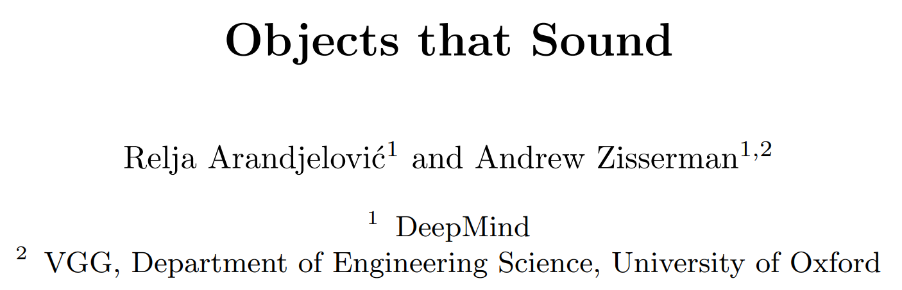
Abstract
Based on this.
Target paper
Results
We can extend the possibilities of applying more general object classes.
Notes:
In order to do this, we build our network based on our target paper, Object that sound. The result shows that our models can learn semantic information from any given audiovisual events. This means that we can generalize object classes.

Slide 6
Introduction
Cross-modal Learning?
Image
Audio
Text
Learning with data having different sources
Notes:
Okay, then let’s start with introduction. What is cross-modal learning? Up to now, people try to train machine learning models across various sources of data such as image, audio and text. In this case, we call this, cross-modal learning. There are variety of fields to use this and one strategy broadly-used is cross-modal retrieval.

Slide 7
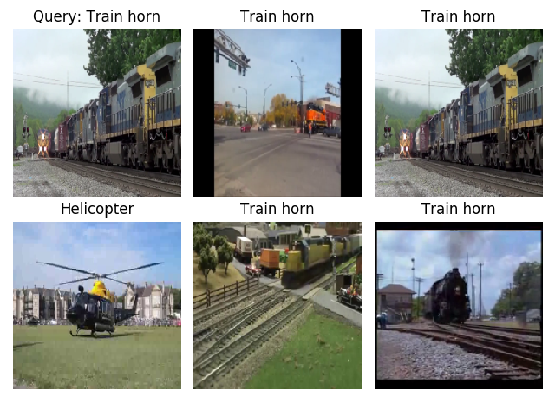
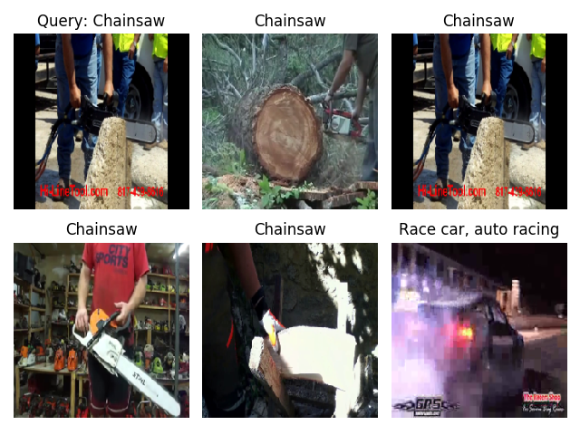

Introduction
Cross-modal retrieval (One result of our experiments)
Audio to Image
Image to Audio
Notes:
This is a cross-modal retrieval example, which comes from our experiment results. If we give query like [click] to the network, then we can retrieve these images which are likely to make that sounds. On the other hand, if we give a chainsaw image to the network, we can receive these audio which are likely to sound from the images. [click]. This means that the network can figure out the correspondence between audio and image.

Slide 8
Introduction
Limitation of existing cross-modal learning works
Supervised learning, or teacher-student supervision.
Require labeled dataset.
Recently,
Self-supervised learning!
Notes:
However, there are some limitations of existing works. They tend to use supervised learning or teacher-student supervision, which requires labeled dataset. But generating labeled datasets is very expensive and tedious for humans. [click] Therefore, recently many works approach this problem in self-supervised learning manner.

Slide 9
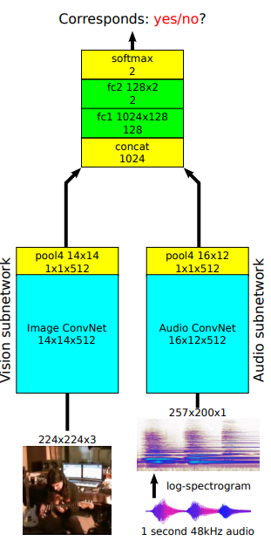
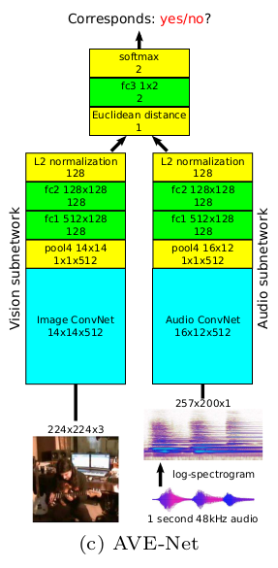
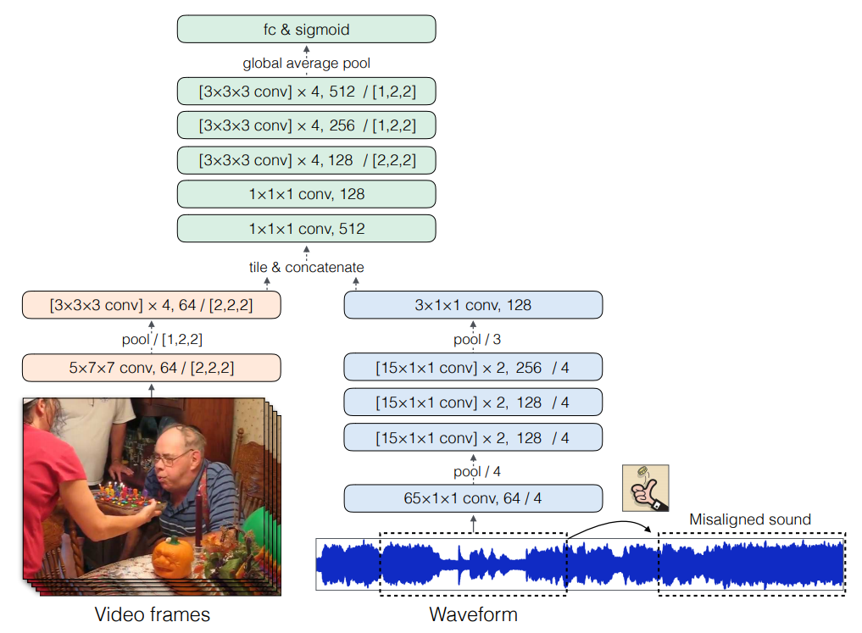
Introduction
Audio-Visual Scene Analysis with Self-Supervised Multisensory Features (ECCV 2018)
Look, Listen and Learn (ICCV 2017)
Objects that Sound (ECCV 2018)
Fuse image and audio + calculate Euclidean distance.
State-of-the-art model.
Multiple video frames and raw sound data without any label.
Fuse image and audio features by concatenating.
Notes:
These are several related works. [click] First paper uses multiple video frames and raw sound data as input through convolutions without any label.
[click] Second paper fuses image and audio features by concatenating to extract the related information. [click] Last paper, which is our target paper, also fuses image and audio but additionally calculate Euclidean distance so that utilizes the semantic information among them. We choose this paper because it is one of the state of the art model and it seems to be possible to utilize this architecture to other objects.

Slide 10
Introduction
Problem?
Like other prior works, only considered very limited object classes (ex. musical instruments).
We tackle this limitation!
Generalize target data to overall objects so that we can learn audio-image embeddings from any object classes.
Notes:
However, as we discussed before, like other prior works, these works also only considered very limited object classes. [click] So we tackle this problem by generalizing target data classes into overall objects.

Slide 11
Approach
1. Replicate target paper
AVE-Net
AVOL-Net
2. Collect datasets
AudioSet dataset
AVE dataset
3. Apply data augmentation
Image: Random flip / crop / color-jitter
Audio: Spectrogram (frequency of an audio signal)
Training & evaluation
Audio-visual correspondence (AVC)
Cross-modal retrieval
Sound localization
Notes:
To summarize our approach, we first replicate our target paper. This includes implementing AVE-Net and AVOL-Net which are main networks for cross-modal learning. Then we collect datasets. AudioSet data is the original dataset of target work, but we also use AVE-dataset for more generalization. Next, we apply data augmentation. We use random flip, crop and so on for images and turn raw audio into frequency of a signal, called spectrogram. Finally, we training our model and evaluate the results. The evaluating task involves audio-visual correspondence, cross-modal retrieval, and sound localization.

Slide 12
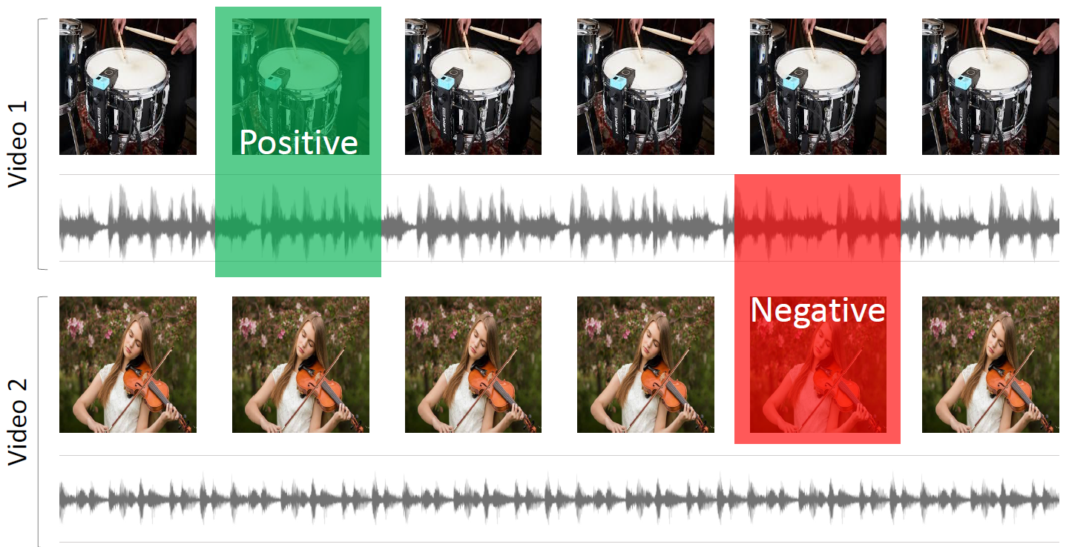
Self-supervised? How?
Pretext task: Correspondence!
Given video to generate sample
Randomly selected video
Notes:
I want to first talk about how these papers train the networks in self-supervised manner.
These works do not use any labels of events happening in the video.
They utilize pretext tasks, using correspondence.
Here, video 1 is given.
To generate True sample, we extract video frame and the audio from the same timestamp.
In contrast to generate False sample, we pair a video frame from video 1 and audio from randomly chosen video 2.

Slide 13


AVC Task
Correspond?
True / False
Model
Proxy task
AVC Task is just a proxy for cross-modal retrieval and sound localization!!!!!
Notes:
This pretext task is called AVC task.
You make model to predict whether given video frame and audio corresponds.
We want to emphasize that AVC task is just a proxy task.
AVC task is just used to let the model perform well on cross-modal retrieval and sound localization.

Slide 14
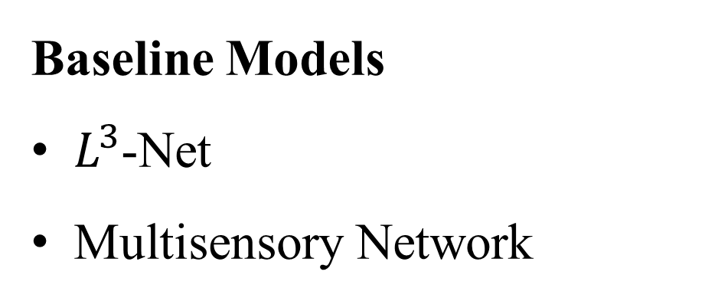
Models
Target Models
AVE-Net
AVOL-Net
Baseline Models
$L^{3}$-Net
Multisensory Network
Notes:
From now on, I will introduce our target and baseline models.

Slide 15
Models
Target Models
AVE-Net
AVOL-Net
Baseline Models
$L^{3}$-Net
Multisensory Network
Replicate
Notes:
We replicate two models in our target paper, and one baseline model.

Slide 16
Models
Target Models
AVE-Net
AVOL-Net
Baseline Models
$L^{3}$-Net
Multisensory Network
Only result
Replicate
Notes:
We only refer to the result of multisensory network.
I will now explain each network one by one.

Slide 17
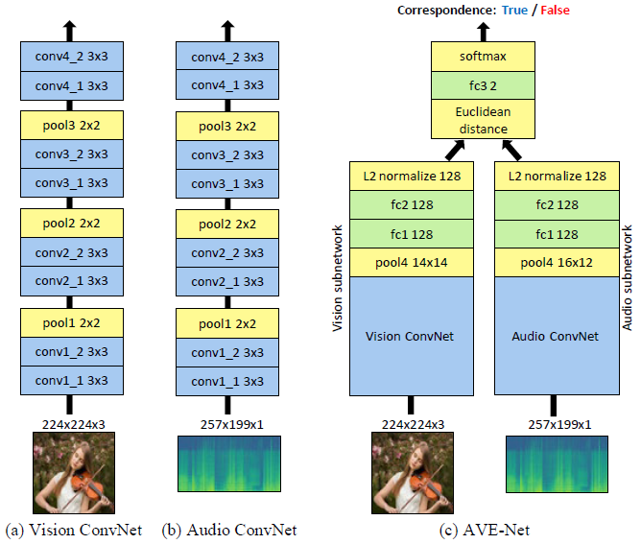
AVE-Net
Notes:
The first is AVE-Net, the objective of this model is to learn how to represent audio and visual data into a vector.
It start by extracting image and audio features with VGG-like CNN.

Slide 18
AVE-Net
Notes:
Then, each features pass through FC layer in each subnetwork, making 128-dimensional embedding vector.

Slide 19
AVE-Net
Notes:
So, the red one is the visual embedding, and the blue one is audio embedding we are going to use in cross-modal retrieval.

Slide 20
AVE-Net
A single value!
Notes:
Finally, a Euclidean distance between audio and visual embedding is computed.
This single value is passed to the tiny FC layer for final prediction.
The cross-entropy loss between the model’s prediction and the correspondence label is computed for optimization.

Slide 21
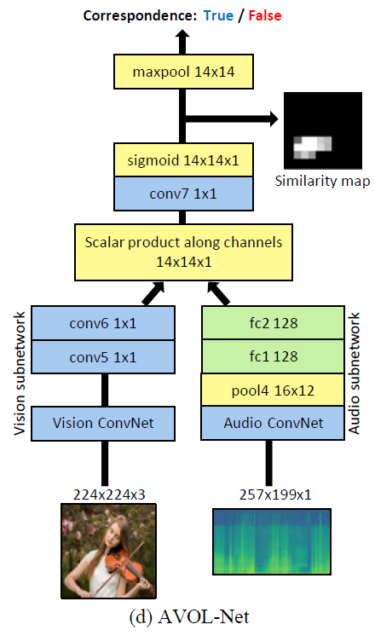
AVOL-Net
Vision subnetwork output
14x14x128
Notes:
Next is AVOL-Net, the goal of this network is sound localization.
The output from the audio subnetwork is similar to AVE-Net.
However, the vision subnetwork gives feature maps having 128 channels.

Slide 22
AVOL-Net
Notes:
After the channel-wise product from two features and the activation,
we can obtain the similarity map that highlights the sound source in the image.

Slide 23
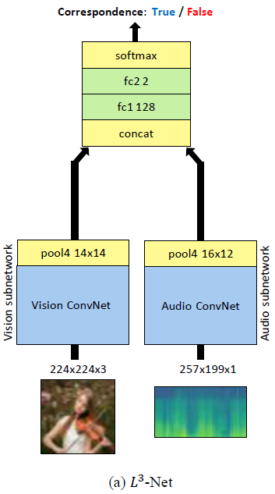
L³-Net
Notes:
L3-Net is our first baseline model.
Unlike to AVE-Net, it just concatenate audio and visual embedding together, rather than giving Euclidean distance.
We also implement this baseline model.

Slide 24
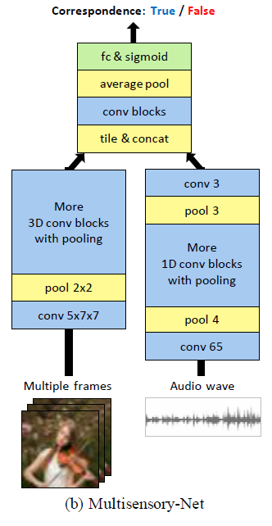
Multisensory Network
Notes:
This is the other baseline model called multisensory network.
It uses multiple video frames and 3D convolution blocks to let the model focus more on spatio-temporal features.

Slide 25
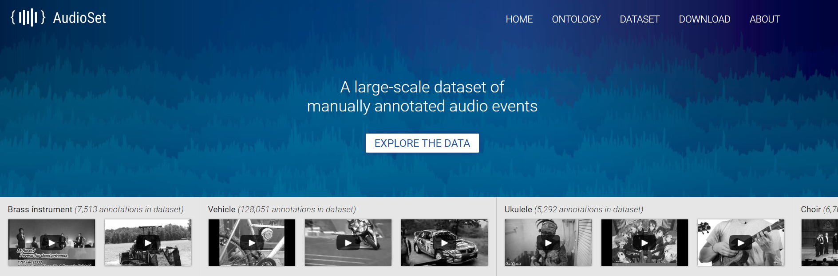
Dataset
AudioSet
Notes:
Let me talk about the dataset from now on.
AudioSet is our base, a large-scale dataset of videos having various kinds of audiovisual events.
We use 3 dataset that is derived from AudioSet.

Slide 26
Dataset
AudioSet-Instruments
(Similar dataset to target paper.)
AudioSet
Notes:
The first one is AudioSet-Instruments.
This dataset has various kinds of videos of playing musical instruments such as violin or clarinet.
Our target paper also use this dataset for training.

Slide 27
Dataset
AudioSet-Instruments
Similar dataset to target paper
We use the 20% subset.
AudioSet-Animals
AudioSet
Notes:
Next one is AudioSet-Animals.
This dataset has lots of animal related videos such as dog barking.
We first use this dataset to confirm the extensibility of the network on other object domains.

Slide 28

Dataset
AudioSet-Instruments
Similar dataset to target paper
We use the 20% subset.
AudioSet-Animals
AVE-Dataset
AudioSet
Various kinds of real world event!
Notes:
The final one is AVE-Dataset.
This dataset has all kinds of real world events such as cooking or running vehicles.
We use AVE-Dataset to the network to check if the network is applicable on any objects or audio events in real life.

Slide 29
Implementation
 | Ours | Paper
Train / Val / Test size | 48k / 6k / 6k | 230k / 30k / 4.3k
Batch size | 64 | 2,048
Learning rate | 5e-5 | Unknown
Optimizer | Adam
Weight decay | 1e-5
GitHub: https://github.com/kyuyeonpooh/objects-that-sound
Notes:
This is some detailed configurations.
We try to use the same settings with the original.
Due to the resource limitation, we use smaller dataset with smaller batch size.
We also find our own appropriate learning rate as it is unknown in the paper.

Slide 30
Models: Review
Target Models
AVE-Net
AVOL-Net
Baseline Models
$L^{3}$-Net
Multisensory Network
Only result
Replicate
Notes:
Let me review about the models before talking about the results.
We replicate target models, AVE and AVOL-Net,
and one baseline model, L3-Net.

Slide 31
Models: Review
Target Models
AVE-Net
AVOL-Net
Baseline Models
$L^{3}$-Net
Multisensory Network
AVC task
Notes:
All these models are using AVC task for training,
so we able to compare the accuracy of all four networks on AVC task.

Slide 32
Models: Review
Target Models
AVE-Net
AVOL-Net
Baseline Models
$L^{3}$-Net
Multisensory Network
Cross-modal Retrieval
Notes:
Next, AVE-Net and L3-Net are both targeting for giving good representation of image and audio.
So these two networks are evaluated for cross-modal retrieval.

Slide 33
Models: Review
Target Models
AVE-Net
AVOL-Net
Baseline Models
$L^{3}$-Net
Multisensory Network
Sound localization
Notes:
Finally, AVOL-Net and multisensory network is targeting for sound localization.
However, we are only going to give qualitative result of AVOL-Net.

Slide 34
Results
1. AVC Task
2. Cross-modal Retrieval
3. Sound Localization
True / False
Model
Proxy task
Notes:
We designed three kinds of experiments: AVC task, cross-modal retrieval, and sound localization. [click]
First is AVC task. It shows how well model figures out the correspondence between video and sound.

Slide 35
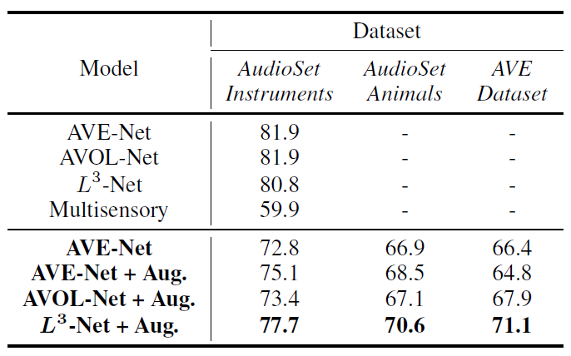
Result 1. AVC Task
Augmentation
AVE-Net: 72.8% → 75.1%
Paper
+
Our
implementation
Table: Accuracy on AVC task of models on different kinds of dataset
Notes:
Let’s see the experiments results on AVC tasks.
This is the accuracy of models on 3 kinds of datasets having different domains.
First, we want to talk about the impact of applying data augmentation on video frame image and spectrogram.
For our improvement, after training AVE-Net with data augmentation, we increased accuracy of AVE-Net from 72% to 75%.

Slide 36
Result 1. AVC Task
Paper > Replication, why?
20% subset of the original dataset in the paper.
Smaller batch size.
Unknown learning rates.
Paper
Our
implementation
Table: Accuracy on AVC task of models on different kinds of dataset
Notes:
Unfortunately, our networks cannot follow up the accuracy suggested in the paper. The reason, we guessed, we used only 20% of the training data due to the resource limitation. And unknown learning rates and smaller batch size also may mislead the networks to the sub-optimal point.

Slide 37
Result 1. AVC Task
Training on broader domain
Relatively low performance.
However, they are able to extract features from other domains!!!
Paper
Our
implementation
Table: Accuracy on AVC task of models on different kinds of dataset
Notes:
Another we got from the experiments is scalability of models.
We tried to train these models on broader domain such as AudioSet-Animals and AVE-Dataset.
Accuracy of models on other datasets is relatively low.
However, we emphasize that their performance is much better than just random guessing.
In other words, the important thing is that model is able to extract some features from videos in other domains.

Slide 38
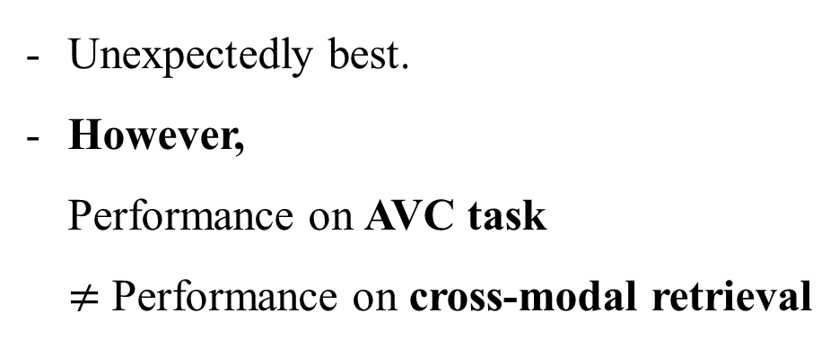

Result 1. AVC Task
Best Accuracy: $L^{3}−Net$
Unexpectedly best.
However, Performance on AVC task $≠$ Performance on cross-modal retrieval
Paper
Our
implementation
Table: Accuracy on AVC task of models on different kinds of dataset
Notes:
Here is the last analysis.
Although L3-Net has unexpectedly shown the best accuracy, the performance on AVC might quite different with the performance on real task, which is cross-modal retrieval.
What we want to know from this experiments is whether the model can construct correspondence between image and audio.

Slide 39
Results
1. AVC Task
2. Cross-modal Retrieval
3. Sound Localization
True / False
Model
Model
Proxy task
Real task
Notes:
Next, we will jump into the result with cross-modal retrieval. [click]
Cross-modal retrieval is a useful measure to evaluate the quality of embedding.
In this case, cross-modal retrieval means retrieving audios that are related to query image, [click]

Slide 40
Results
1. AVC Task
2. Cross-modal Retreival
3. Sound Localization
True / False
Model
Model
Proxy task
Real task
Notes:
Or vice versa.
Cross-modal retrieval is one of the real goal of the models,
So the results here are more important than the performance of AVC task.

Slide 41
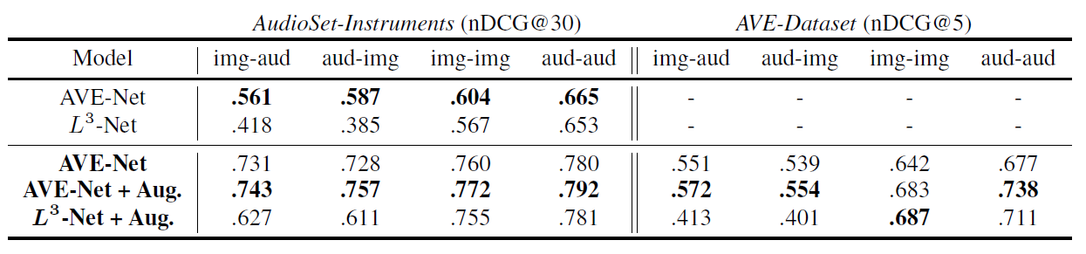
Result 2. Cross-modal Retrieval
Table: Cross-modal and intra-modal retrieval performance of AVE-Net and L³-Net on AudioSet-Instruments and AVE-Dataset.
Euclidean distance
Low distance: high similarity (retrieved first)
High distance: low similarity (retrieved later)
Notes:
We retrieve items comparing the Euclidean distance of embeddings.
For example, if the Euclidean distance between two embeddings have low distance, it has high similarity.

Slide 42
Result 2. Cross-modal Retrieval
Table: Cross-modal and intra-modal retrieval performance of AVE-Net and L³-Net on AudioSet-Instruments and AVE-Dataset.
Paper
Our
implementation
Paper < Replication, why?
Our dataset is a subset of the original, having smaller classes of video
→ Advantageous to the dataset in the paper.
Notes:
Let’s first compare the performance in the paper to our implementation. Our replications produce much better nDCG than the paper.
However, as we mentioned before, our dataset is a subset of the original, so may take advantage of smaller dataset.

Slide 43
Result 2. Cross-modal Retrieval
Table: Cross-modal and intra-modal retrieval performance of AVE-Net and L³-Net on AudioSet-Instruments and AVE-Dataset.
Paper
Our
implementation
Augmentation
→ Also helpful to obtain embedding with better quality!
Notes:
Next, after applying data augmentation, the retrieval performance also becomes better.
This means data augmentation also helps the model to perform better on not only AVC task but also on generating embeddings.

Slide 44
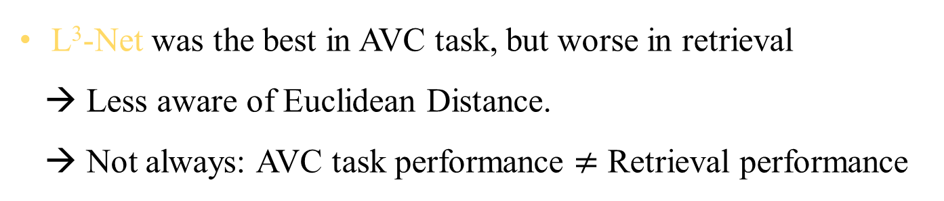
Result 2. Cross-modal Retrieval
Table: Cross-modal and intra-modal retrieval performance of AVE-Net and L³-Net on AudioSet-Instruments and AVE-Dataset.
Paper
Our
implementation
L³-Net was the best in AVC task, but worse in retrieval
→ Less aware of Euclidean Distance.
→ Not always: AVC task performance $≠$ Retrieval performance
Notes:
Next is about L3-Net.
L3-Net shows the best performance in AVC task.
However, because L3-Net is less aware of Euclidean distance, AVE-Net shows better retrieval quality than L3-Net.

Slide 45
Result 2. Cross-modal Retrieval
Table: Cross-modal and intra-modal retrieval performance of AVE-Net and L³-Net on AudioSet-Instruments and AVE-Dataset.
Paper
Our
implementation
Application on broader domain (AVE-Dataset)
→ Reasonable compared to what authors obtained! → AVE-Net is still superior to L³-Net (especially cross-modal retrieval).
Notes:
Lastly, we conduct the same experiment with AVE-Dataset.
Because the test size of AVE-Dataset is only about 300, we found evaluating with top 5 items is reasonable measure.
Although the performance AVE-Dataset is relatively lower than the previous dataset,
Recall that domain of videos in AVE-Dataset is much larger than AudioSet-Instruments.
We also can find that AVE-Net is still superior to L3-Net in comprehensive dataset.

Slide 46

Results
1. AVC Task
2. Cross-modal Retreival
3. Sound Localization
True / False
Model
Model
Model
Proxy task
Real task
Real task
Notes:
Last is the sound localization. [click]
It shows how well the model construct attention map for sound localization.

Slide 47
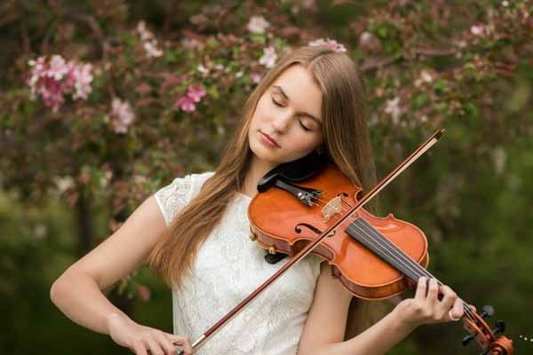
Result 3. Sound Localization
Input Image
(224, 224, 3)
Scaled Attention Map
(14, 14) to (224, 224)
Results
(224, 224, 3)
Notes:
We scale the similarity map of 14 by 14 resolution16 times, so that the image can be completely overlapped with the similarity map.

Slide 48
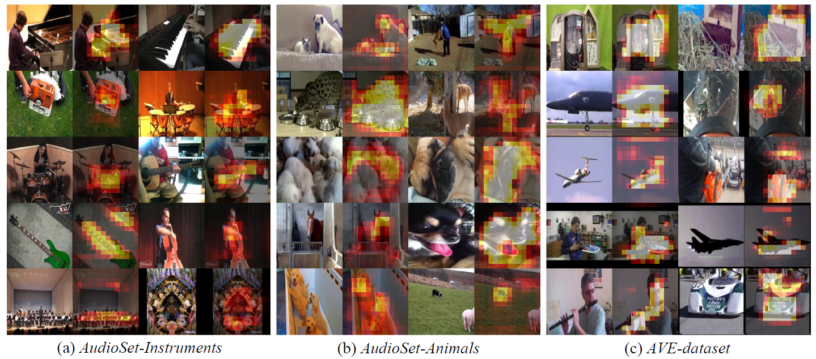
Result 3. Sound Localization
Figure: Qualitative results of sound localization on different datasets
Notes:
We focus on giving a qualitative result of sound localization.
We get qualitative result from all suggested dataset.
You can confirm that model is giving attention to the sounding object,
And works reasonably well on all domain.

Slide 49
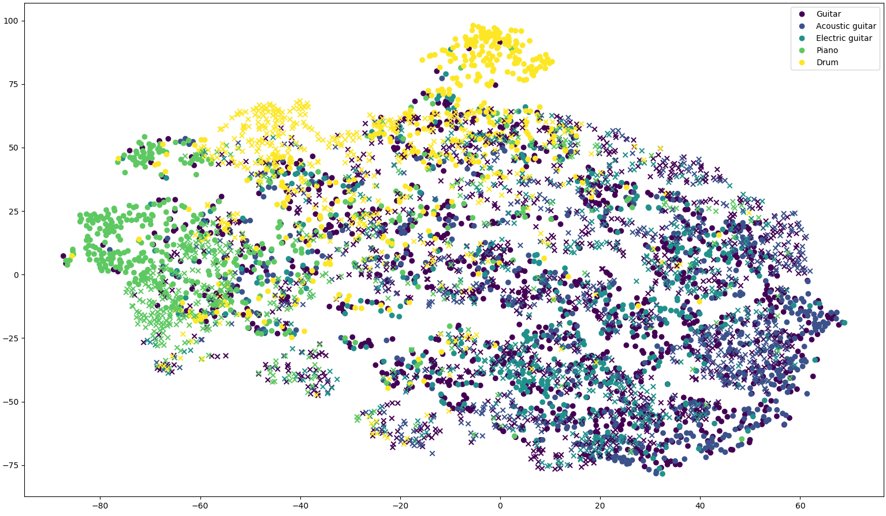
Supplementary Result: Visualizing with t-SNE
O is visual embedding
X is audio embedding
Notes:
We visualize the embedding space with t-SNE.
You can see that audio and visual embeddings are well-aligned each other.
Especially, guitar related embeddings are located near each other.

Slide 50
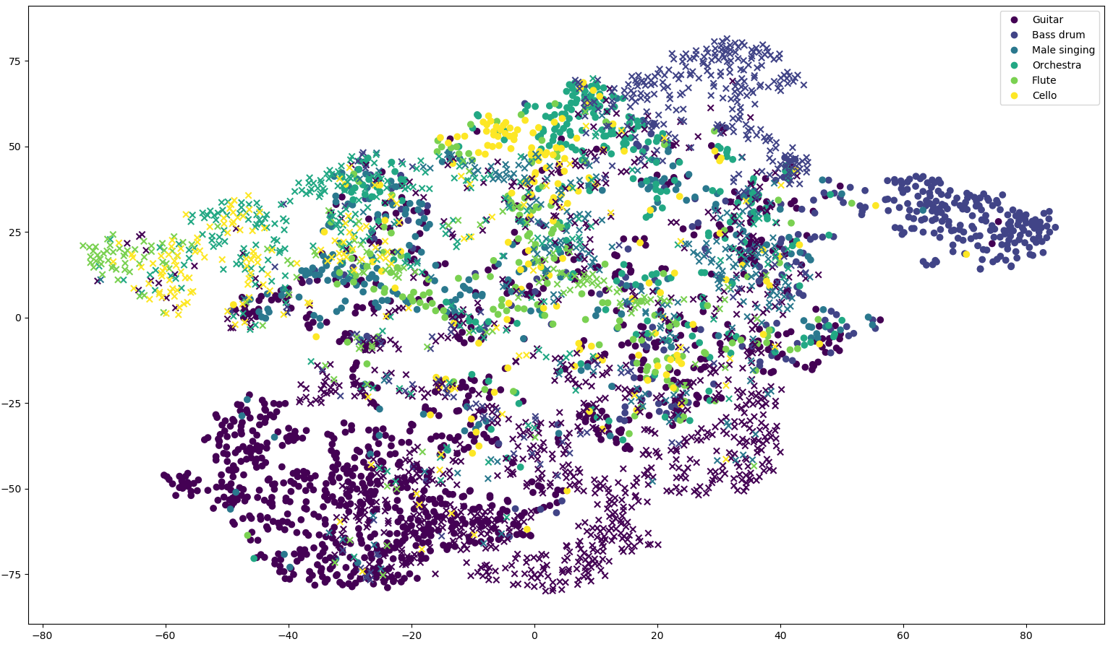
Supplementary Result: Visualizing with t-SNE
O is visual embedding
X is audio embedding
Notes:
This is the other t-SNE visualization with the objects from other domain.

Slide 51
Discussion
Is suggested audiovisual models able to generalize their task with any objects?
1. Collect more various dataset not only limited to musical instruments
2. Apply data augmentation for image and audio
But, still needs some change in model architecture for capturing more generalized correspondence
Notes:
Up to now, we tried to solve the question, is suggested audiovisual models able to generalize their task with any objects?
To answer this question, we first collect more various datasets not only limited to musical instruments. Then, proved the suggested model worked even with humans, animals, and whatever existing around.
Moreover, we successfully applied data augmentation on image and audio, which shows significant performance improvement.
However, modification in model architecture for capturing more generalized correspondence is left as future work.

Slide 52
Thank you
Notes:
Thank you very much for your listening.

